Slide 1
HEALTH QUEST MEDICALS

Slide 2

ABOUT US
Health Quest Medicals, a leading pharmaceutical company is committed to delivering high-quality medical solutions. Our mission is to improve the health and well-being of patients through cutting-edge research and development, advanced technologies, and innovative treatments.
Our team of experts includes Research Scientists, Laboratory Technicians, Healthcare Representatives, Research Directors etc., all work together to ensure that our patients receive the best possible pharmaceutical care. We are dedicated to staying at the forefront of medical advancements, and our research and development efforts are aimed at bringing new pharmaceutical products to market that meet the evolving needs of patients.
At Health Quest Medicals, we understand the importance of pharmaceutical care. We are dedicated to improving the health and well-being of our patients and are proud to serve the communities in which we operate.

Slide 3

PROBLEM OVERVIEW
Health Quest has hired you as a Data
Professional. Health Quest wants you to provide valuable insights into the company's workforce and help identify areas for improvement. They need a
better understanding of their employee demographics and descriptive statistics.

Slide 4

DATA DICTIONARY
Age;
Attrition;
EmployeeNumber;
Gender;
BusinessTravel;
Department;
DistanceFromHome;
Education;
EducationField;
EnvironmentSatisfaction;
JobInvolvement;
JobLevel;
JobRole;
JobSatisfaction;
MaritalStatus
The age of the employee. (Numerical)
Whether or not the employee has left the organization. (Categorical) A unique identifier for each employee profile. (Numerical)
The gender of the employee. (Categorical)
The frequency of business travel for the employee. (Categorical) The department the employee works in. (Categorical)
The distance from home in miles for the employee. (Numerical)
The level of education achieved by the employee. (Categorical) The field of study for the employee's education. (Categorical)
The employee's satisfaction with their work environment. (Categorical) The level of involvement required for the employee's job. (Categorical) The job level of the employee. (Categorical)
The role of the employee in the organization. (Categorical) The employee's satisfaction with their job. (Categorical) The marital status of the employee. (Categorical)

Slide 5

DATA DICTIONARY
MonthlyIncome;
NumCompaniesWorked;
Over18;
OverTime;
PercentSalaryHike;
PerformanceRating;
RelationshipSatisfaction;
TotalWorkingYears;
TrainingTimesLastYear;
WorkLifeBalance;
YearsAtCompany;
YearsInCurrentRole;
YearsSinceLastPromotion;
YearsWithCurrManager;
The monthly income of the employee. (Numerical)
The number of companies the employee has worked for. (Numerical) Whether or not the employee is over 18. (Categorical)
Whether or not the employee works overtime. (Categorical)
The percentage of salary hike for the employee. (Numerical)
The performance rating of the employee. (Categorical)
The employee's satisfaction with their relationships. (Categorical) The total number of years the employee has worked. (Numerical)
The number of times the employee was taken for training in the last year. (Numerical) The employee's perception of their work-life balance. (Categorical)
The number of years the employee has been with the company. (Numerical)
The number of years the employee has been in their current role. (Numerical) The number of years since the employee's last promotion. (Numerical)
The number of years the employee has been with their current manager. (Numerical)

Slide 6
EXTRA-INFO
Education: The level of education achieved by the employee. It is a categorical variable with five values: "Below College",
"College", "Bachelor", "Master", and "Doctor".
EnvironmentSatisfaction: The employee's satisfaction with their work environment. It is a categorical variable with four values: "Low", "Medium", "High", and "Very High".
JobInvolvement: The level of involvement required for the employee's job. It is a categorical variable with four values: "Low", "Medium", "High", and "Very High".
JobLevel: The job level of the employee. It is a categorical variable with five values: "Entry Level", "Intermediate Level 1", "Intermediate Level 2", "Advanced Level", and "Executive Level".
JobSatisfaction: The employee's satisfaction with their job. It is a categorical variable with four values: "Low", "Medium", "High", and "Very High".
RelationshipSatisfaction: The employee's satisfaction with their relationships. It is a categorical variable with four values: "Low", "Medium", "High", and "Very High".
WorkLifeBalance: The employee's perception of their work-life balance. It is a categorical variable with four values: "Bad", "Good", "Better", and "Best

Slide 7

What is the average age of employees, and how does this vary across departments?
What is the distribution of education levels within the company, and is there a predominant education field
among employees?
How satisfied are employees with their work environment?
Do you think the longer an employee commutes to the office, the higher their monthly take home? What of a relationship between years at company and percent salary hike?
What is the average monthly income of employees per department, and what is the corresponding deviation from
this value?
Is there Gender discrimination in terms of renumeration?
Considering the monthly income of employees, which Job role has the lowest income range. Provide a pictorial representation.
What is the distribution of the years, when employees were last promoted?
What is the attrition rate within the company.
What is the median income distribution across educational levels.
Determine the median Age for employees who have and have not worked overtime. What might this indicate about the potential health impacts of overtime?
Compare the frequented JobSatisfaction ratings across different Departments. What can you deduce?

Slide 8
1. What is the average age of employees, and how does this vary across departments?
Departments | Average Age of employees
Human Resources | 38
Research & Development | 37
Sales | 37
Grand Total | 37.1315962

Slide 9
2. What is the distribution of education levels within the company, and is there a predominant education field among employees?
Employees with Bachelor’s Degree Level appear to be more predominant.

Slide 10
3. How satisfied are employees with their work environment?
Environment Satisfaction | Count of Environment Satisfaction
Medium | 287
High | 453
Very High | 446
LOW | 284
We have 31% satisfied with 453 employees in the HIGH-level region and 30% with 446 employees in the VERY HIGH-level region. We have 899 employees out of 1470 with 61% who are very satisfied.

Slide 11
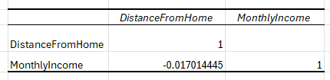

4. Do you think the longer an employee commutes to the office, the higher their monthly take home? What of a relationship between years at company and percent salary hike?
No correlation btw an employees monthly income and how long an employee commute to the office.
There is no relationship between between years at the company and the percent salary hike?

Slide 12
5. What is the average monthly income of employees per department, and what is the corresponding deviation from this value?
Sales 6,959.17
Research & Development 6,281.25
Human Resources 6,654.51
STDEVIATION = 339.5377175

Slide 13
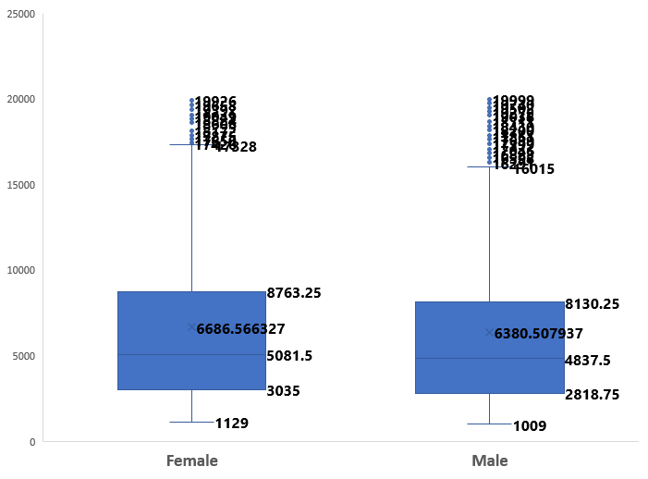
What is Gender discrimination in terms of remuneration?
There is no gender discrimination btw Males and Females in terms of remuneration because the range of average income value and mean are very close.

Slide 14
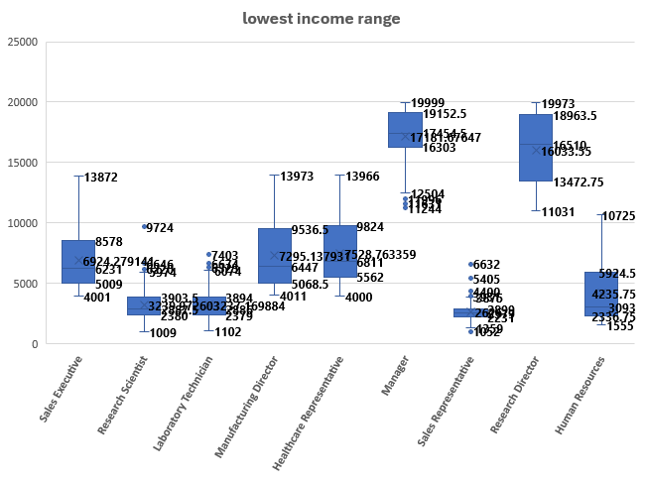
7. Considering the monthly income of employees, which Job role has the lowest income range. Provide a pictorial representation.
JOB ROLE | Average of Monthly Income
Manager | 17,181.68
Research Director | 16,033.55
Healthcare Representative | 7,528.76
Manufacturing Director | 7,295.14
Sales Executive | 6,924.28
Human Resources | 4,235.75
Research Scientist | 3,239.97
Laboratory Technician | 3,237.17
Sales Representative | 2,626.00
Grand Total | 6502.93
THE SALES REPRESENTATIVE Role has the lowest income range with a total of 2,626

Slide 15
8. What is the distribution of the years, when employees were last promoted?
Lesser/Lower amount of employees were promoted as the number of years increased.

Slide 16
9. What is the attrition rate within the company.
The attrition rate is the pace at which people leave a company The attrition rate for this Company is LOW at 16% meaning only 237 left out of 1470 which means more employees stayed with the company.

Slide 17
10. What is the median income distribution across educational levels?
 | Median Distribution
College | 4892
Below college | 3849
Master | 5342
Bachelor | 4762
Doctor | 6203

Slide 18

11.Determine the median Age for employees who have and have not worked overtime. What might this indicate about the potential health impacts of overtime?
No correlation between age and work life balance. Age does not determine if the employee has good health or Good work life balance

Slide 19
12. Compare the frequented Job Satisfaction ratings across different Departments. What can you deduce?
Row Labels | % of Job Satisfaction
Human Resources | 4.3%
Research & Development | 65.4%
Sales | 30.3%
Grand Total | 100.00%
Employees in Research dept (64%) are more satisfied followed by sale dept (30.0%) while employees at the Human resource (4.3%) are less satisfied.

